Slide 1
Final presentation
Phylogenetic tree analysis of SARS-CoV-2 genomes
using Neighbor-Joining method

Slide 2
Outline
Introduction to NJ method
Comparison between NJ and other methods
Boostrapping
Result analysis

Slide 3
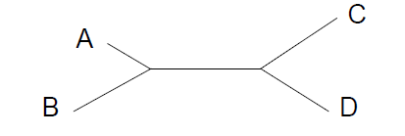
Neighbor Joining (NJ)
Neighbors = pair of nodes who have one node connecting them.
Nodes A and B are neighbors (connected by only one internal node)
Nodes C and D are neighbors.
Nodes A and C are not neighbors. (A, D), (B, C), (B, D) are not neighbors.
Neighbor-joining:
Saitou N, Nei M. (1987) The neighbor-joining method: a new method for reconstructing phylogenetic
trees. Mol Biol Evol. 4:406-25.
Notes:
(sequences, OTUs)
OUT: operational taxonomic unit

Slide 4
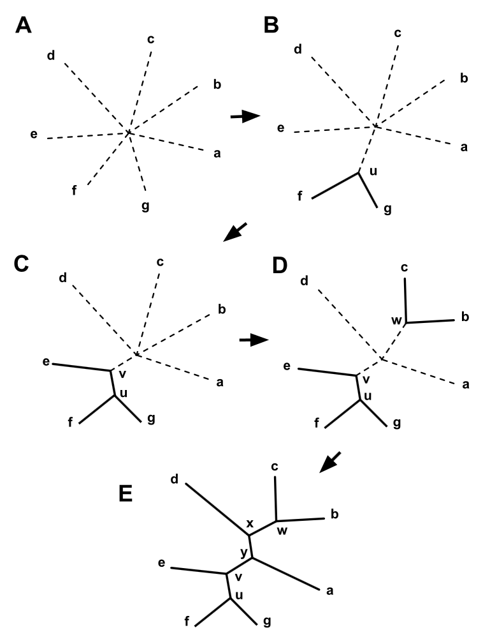
Neighbor-Joining: Principle
How to find neighbors? How to construct the tree?
0. Start with a “star” tree and a n by n distance matrix.
Calculate the Q matrix based on distance matrix.
Find the pair i and j for which Q(i,j) has its lowest value. Join i and j to create a node node, which is connected to the central node. Update lengths/weights of new branch (i.e., calculate distance from the pair members to the new node.
Update the distance matrix [(n-1) by (n-1)], i.e., calculate the distance from each node to the new node.
Repeat 1-3 with the updated distance matrix.

Slide 5
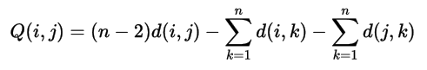
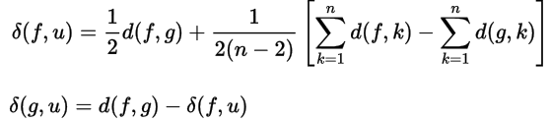
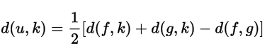
Neighbor-Joining: Principle
Calculate the Q matrix based on distance matrix. Join (i,j) with smallest Q(i,j)
Calculate lengths/weights of new branch.
Update distance matrix.

Slide 6
UPGMA
Assumption: evolution rate in different germlines keeps the same
Go WRONG when rates differ

Slide 7
MP
Do not rely on statistic method of any evolution model
Mutations happen mysterious
Go WRONG when the number of nucleotides substitution is massive

Slide 8
ML
Depends on the selection of nucleotides substitution model
The correctness of topology and the estimation precision of branch length could not be satisfied together
Bad method when number of groups are big

Slide 9
Assessing significance of Tree
Bootstrapping methods are used.
Given an alignment, randomly pick columns from alignment with replacement.(放回式抽样)
Apply tree building to new data set.
Repeat selection a number of times.
The frequency with which each clade in the original tree is observed is measure of confidence for that clade.
Notes:
使用引导方法。
给定对齐方式后，从对齐方式和替换方式中随机选择列。（放回式抽样）
将树构建应用于新数据集。
重复选择次数。
观察原始树中每个包层的频率是对该包层的置信度。

Slide 10
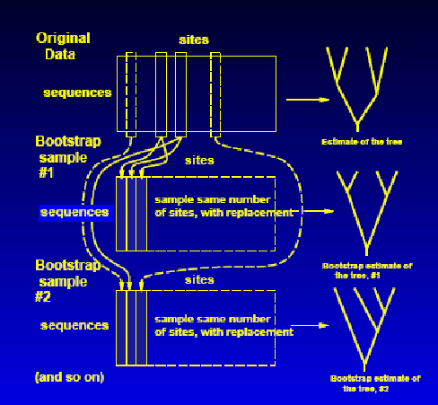
Bootstrapping

Slide 11
Bootstrapping Sample
 | 6 | 5 | 4 | 3 | 6 | 7 | 2 | 3 | 9
a | T | G | A | G | T | G | A | G | A
b | T | G | C | C | T | G | G | C | G
c | T | A | T | A | T | G | G | A | A
d | T | A | G | A | T | G | G | A | G
a
b
c
d
 | 1 | 2 | 3 | 4 | 5 | 6 | 7 | 8 | 9
a | A | A | G | A | G | T | G | C | A
b | A | G | C | C | G | T | G | C | G
c | A | G | A | T | A | T | G | C | A
d | A | G | A | G | A | T | G | C | G
Sample
Original sequences

Slide 12
Speed-up method: multiprocessing
multiprocessing is a package that supports spawning processes using an API similar to the threading module.
The multiprocessing package offers both local and remote concurrency, effectively side-stepping the Global Interpreter Lock by using subprocesses instead of threads.
Due to this, the multiprocessing module allows the programmer to fully leverage multiple processors on a given machine.
Notes:
multiprocessing是一个程序包，它使用类似于线程模块的API支持生成过程。
多处理程序包提供本地和远程并发，通过使用子进程而不是线程来有效地避开全局解释器锁。
因此，多处理模块允许程序员充分利用给定机器上的多个处理器。

Slide 13
Multiprocessing vs. Multithreads
Due to Global Interpreter Lock in Python, one process has only one thread. Multiprocessing usually have better performance.
CPU intensive tasks: Multiprocessing
IO intensive tasks: Multithreads

Slide 14
Speed-up result: CPU usage
Intel i7-10750H: 8 cores
Multiprocessing: ~100%
Singleprocessing: ~30%
MegaX: ~50%

Slide 15
Helpful tool: iTOL
Interactive Tree Of Life
Annotate trees with various types of data and export to various graphical formats; scriptable through a batch interface
Ivica Letunic and Peer Bork
EMBL, Heidelberg, Germany
Notes:
欧洲分子生物学实验室
德国海德堡
用各种类型的数据注释树并导出为各种图形格式；可通过批处理界面编写脚本

Slide 16
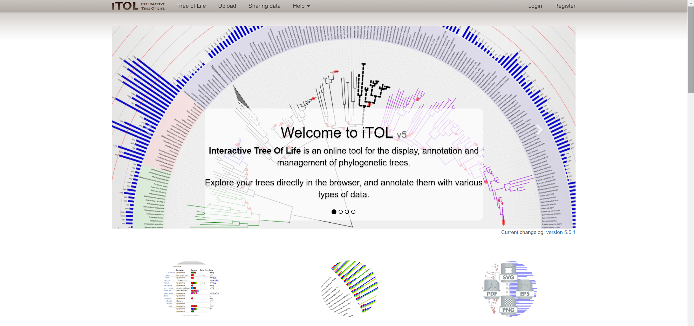
Helpful tool: iTOL

Slide 17
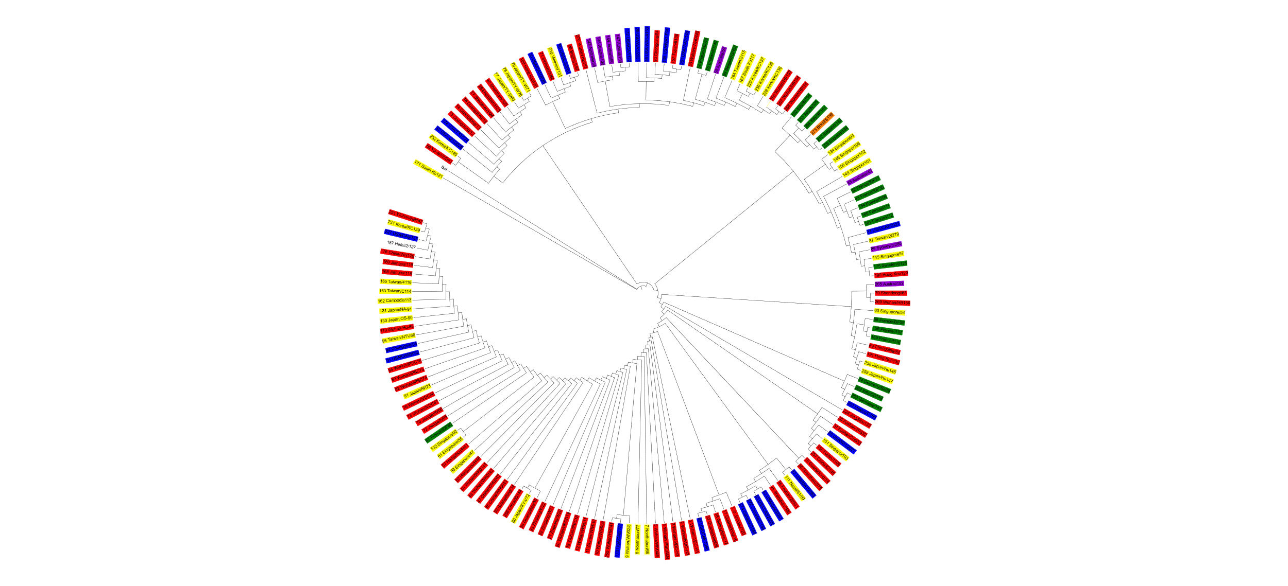
Result
Red-China Mainland
Yellow-rest of East Asia
Blue-North America
Green-Europe
Purple-Australia

Slide 18
Result: Why not root tree?
Root tree seems hard to read and analysis.
Though a sequence from bat’s coronavirus is included, it is not very proper to be the outgroup.

Slide 19

Result
Red-China Mainland
Yellow-rest of East Asia
Blue-North America
Green-Europe
Purple-Australia

Slide 20
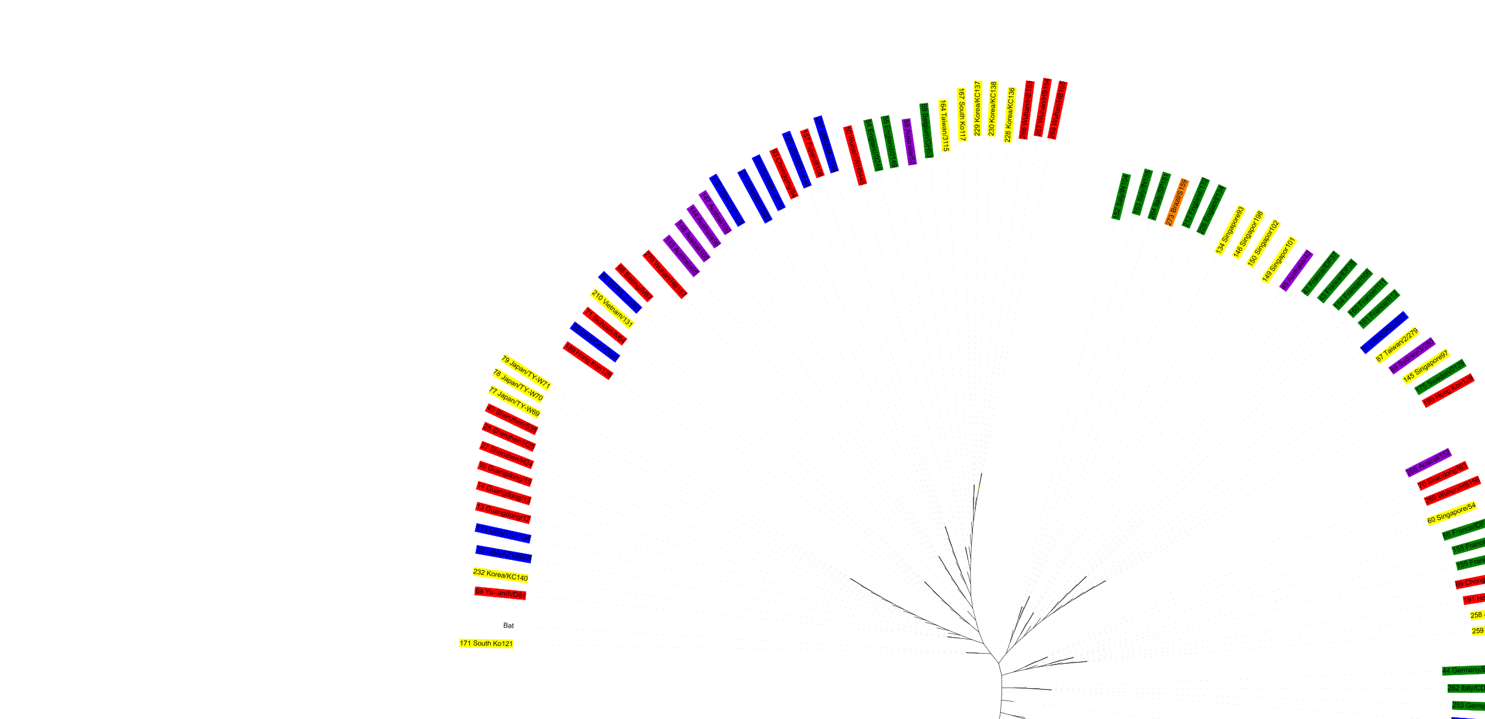
Result

Slide 21
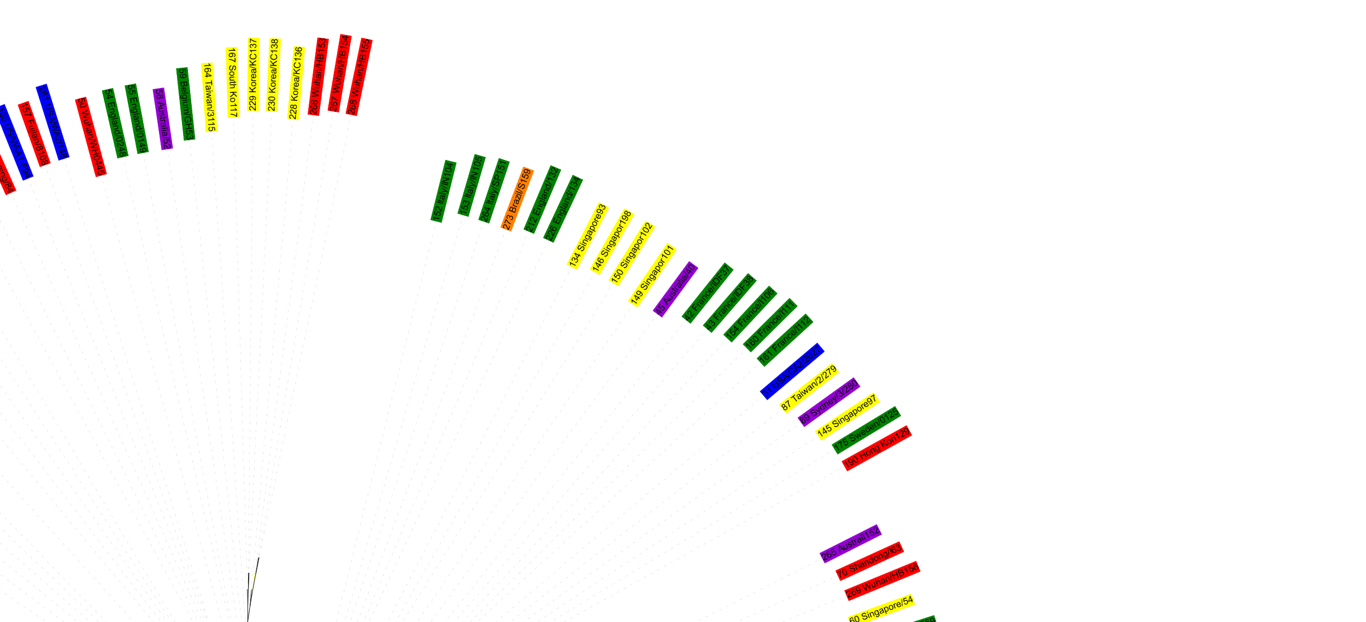
Result

Slide 22
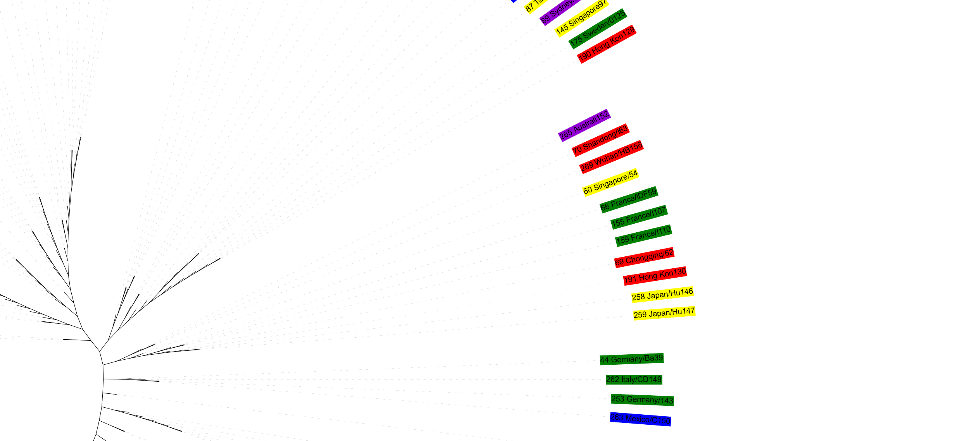
Result

Slide 23
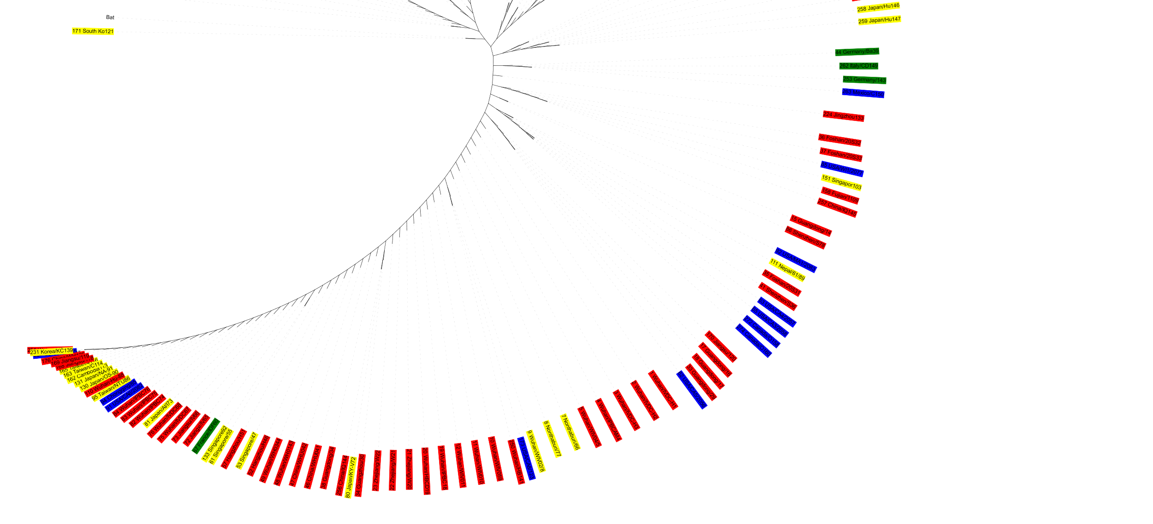
Result

Slide 24
Future work
More complicated distance matrix (transitions vs transversions, K2P......)
Improve of NJ
Automatically draw a tree

Slide 25
Thanks!

